Slide 1

Reducing Carbon Emissions in Mesa, AZ
SPRING ‘25
Team Venus
FSE 570
Notes:
This is the first slide. We can change images eventually.

Slide 2
1.
Introduction
2.
Objectives
3.
Methodology
4.
Results
5.
Conclusion and Significance

Slide 3
Quick Numbers
645 heat related deaths in Maricopa County in 2023
Phoenix is top 5 worst cities in the US for ozone pollution (lung.org)
100+ degree days expected to rise by over 25% in the coming years

Slide 4
Mesa’s average daily temperature has climbed by roughly 2º F over the past two decades, resulting in 80+ days per year above 100º F.
Vehicle-based CO₂ emissions, which make up nearly one-third of the city’s greenhouse gases are the primary driver of this warning and the urban heat island effect
Notes:
This slide (maybe one more in a similar format) should be about temperature trends and bus trends in mesa, and how carbon emissions are the major cause of rising tempratures

Slide 5
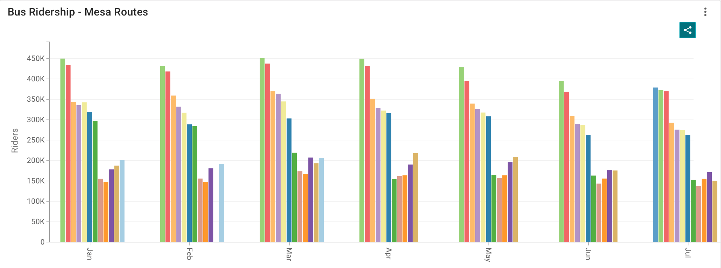
Monthly bus ridership since January 2014
2021 and 2022 were the worst years - likely due to the pandemic
Current ridership is still not as high as pre-pandemic (recession?)

Slide 6
Forecasts performed project another ~ 1º F rise by 2029, intensifying heat related health risks.
Yet monthly bus boardings have flatlined despite a 10% population increase, leaving a major opportunity for transit authorities to curb emissions, unfulfilled
Notes:
This slide (maybe one more in a similar format) should be about temperature trends and bus trends in mesa, and how carbon emissions are the major cause of rising tempratures

Slide 7
1.
Introduction
2.
Objectives
3.
Methodology
4.
Results
5.
Conclusion and Significance

Slide 8
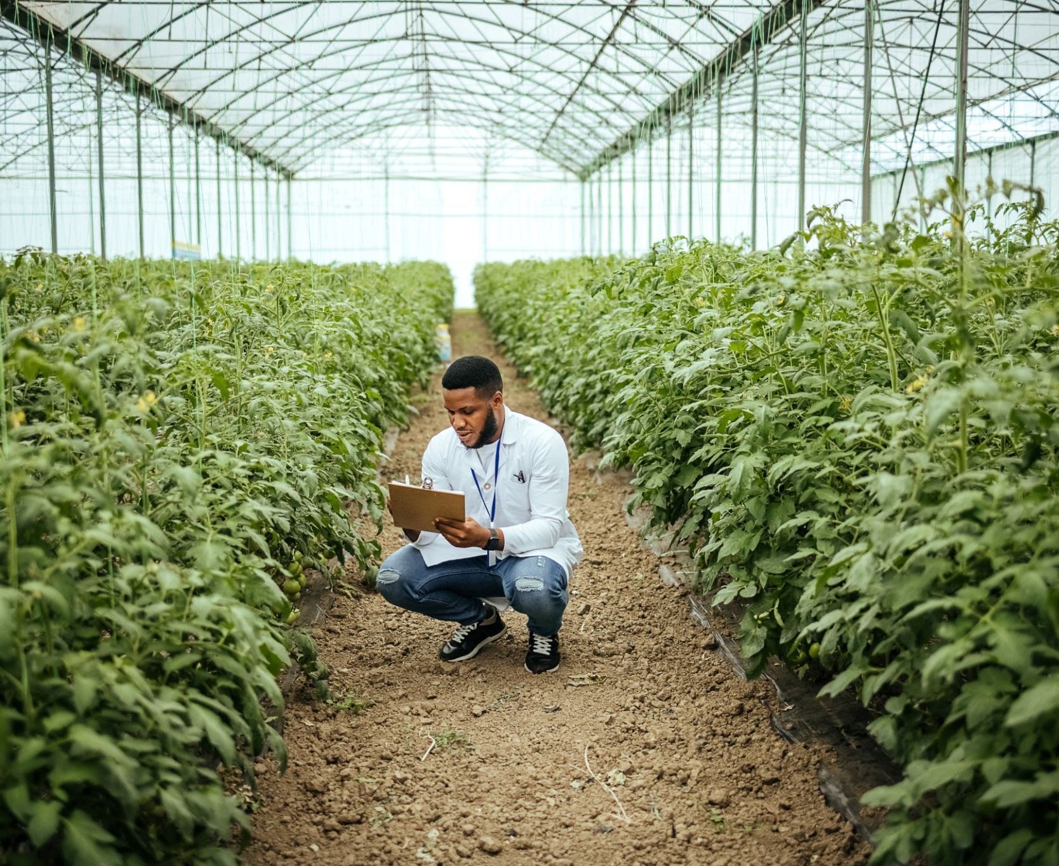
Identify census tracts underserved by current bus service
Design new bus routes with stops to enhance coverage
Forecast Temperature trends to correlate transit uptake with heat mitigation
Evaluate financial feasibility and optimal budget allocation
Estimate potential reduction in CO2 emissions.
Notes:
Our objectives need to explain that due to aforementioned issues (rising temperatures, carbon emissions), our objective to reduce the emissions comes through an increase in bus routes across mesa and promoting public transit.(change the picture, or edit it. We dont need to stick with this slide design, just the theme)

Slide 9
1.
Introduction
2.
Objectives
3.
Methodology
4.
Results
5.
Conclusion and Significance

Slide 10
Data Acquisition and Preprocessing in Excel and QGIS.
Spatial Join and Choropleth Mapping to reveal service gaps and population comparisons.
Transit Coverage Analysis : Selecting census tracts without routes.
Digitizing proposed bus lines and stop locations in QGIS.
Temperature forecasting with LSTM (30-day) & ARIMA (5-Year).
Financial analysis : Budget Reallocation and cost estimates
Notes:
All about our methodology - the data sets we used and procured (bus ridership, temperature datasets, GIS datasets - census tracts, public transit routes and stops, population data), how we performed the bus ridership analysis and a basic idea of what we gained from it, how we performed the rising temperature analysis, and GIS analysis. Check report for info most of the stuff should be there or discuss in the group. Add slides as we seem fit, but since this is a presentation we need to keep the text limited and explain our work more.

Slide 11
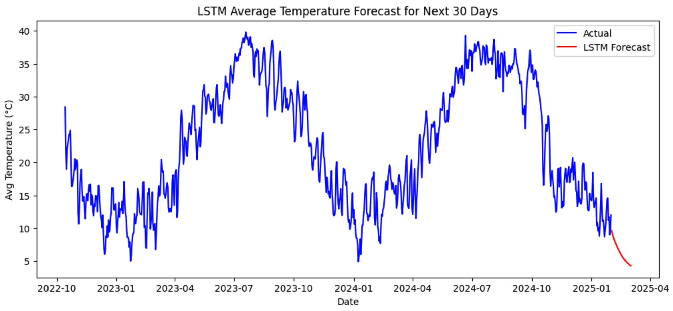
Temperature Forecasting
LSTM Model (TensorFlow) :
• Forecast next 30 days of average temperatures
• 2 layers × 50 units, Adam optimizer, MSE loss (20 epochs, batch size 16)
Notes:
All about our methodology - the data sets we used and procured (bus ridership, temperature datasets, GIS datasets - census tracts, public transit routes and stops, population data), how we performed the bus ridership analysis and a basic idea of what we gained from it, how we performed the rising temperature analysis, and GIS analysis. Check report for info most of the stuff should be there or discuss in the group. Add slides as we seem fit, but since this is a presentation we need to keep the text limited and explain our work more.

Slide 12
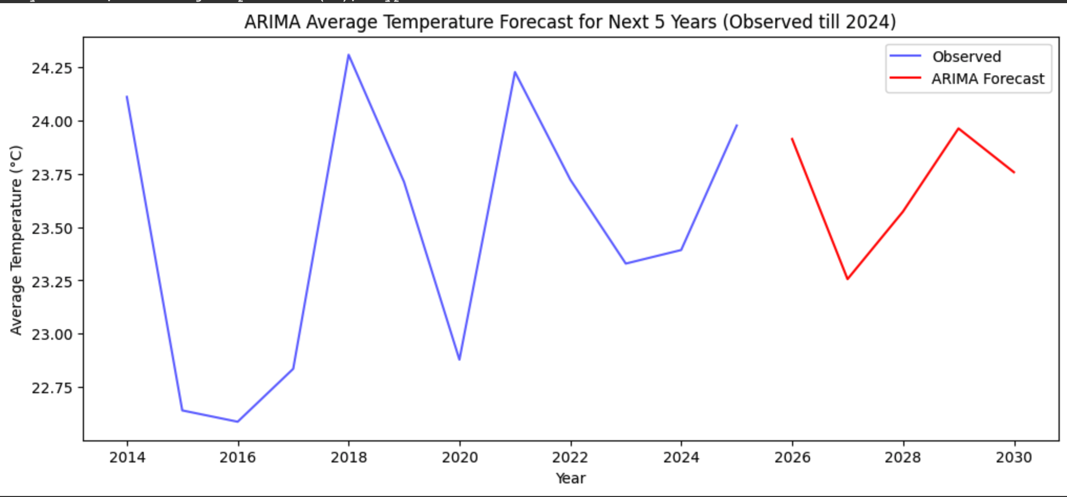
Temperature Forecasting
ARIMA Model (statsmodels) :
• Project average temperatures 2025–2029
• RMSE = 0.387°C, MSE = 0.362°C
Notes:
All about our methodology - the data sets we used and procured (bus ridership, temperature datasets, GIS datasets - census tracts, public transit routes and stops, population data), how we performed the bus ridership analysis and a basic idea of what we gained from it, how we performed the rising temperature analysis, and GIS analysis. Check report for info most of the stuff should be there or discuss in the group. Add slides as we seem fit, but since this is a presentation we need to keep the text limited and explain our work more.

Slide 13
GIS Analysis
Initial Setup : Created a base layer and added Mesa city boundaries, along with projections of the current bus routes and stops across the city
Spatial Join & Choropleth Mapping: Joined Mesa census tracts with ACS population data and styled by density tiers to reveal population spread on a map.
Coverage Gap Identification: Isolated tracts with no intersection of existing bus routes—highlighting underserved NE and SE Mesa.
Route & Stop Digitization: Created five new bus corridors following major roads; extracted vertices along those lines to propose 45 potential stop locations.
Symbology & Refinement: Applied categorized and rule-based symbology, adjusted layer transparency, and overlaid on OpenStreetMap for clear context.
Notes:
All about our methodology - the data sets we used and procured (bus ridership, temperature datasets, GIS datasets - census tracts, public transit routes and stops, population data), how we performed the bus ridership analysis and a basic idea of what we gained from it, how we performed the rising temperature analysis, and GIS analysis. Check report for info most of the stuff should be there or discuss in the group. Add slides as we seem fit, but since this is a presentation we need to keep the text limited and explain our work more.

Slide 14
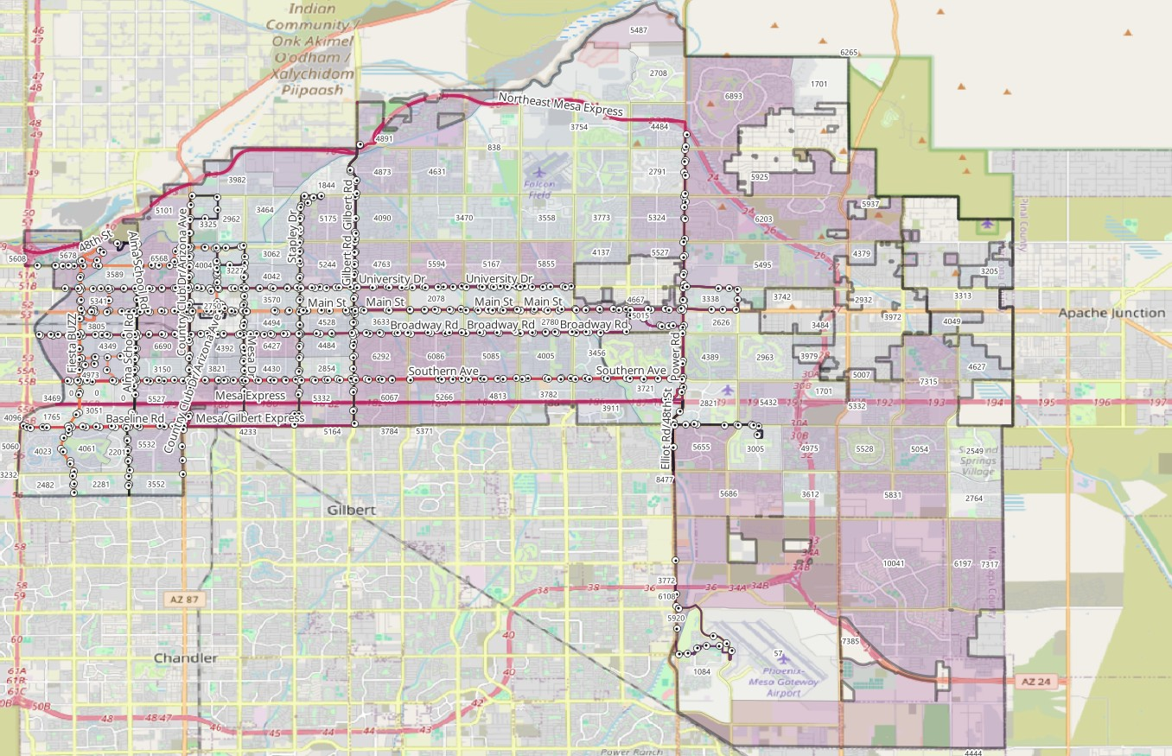
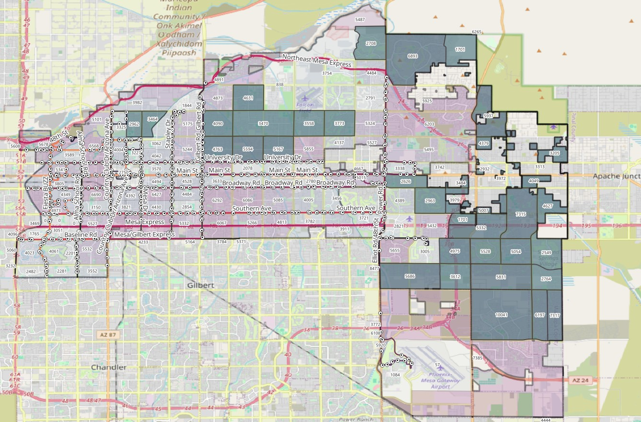
Mesa - Present day transit and population layout
Mesa areas and their populations in accordance with census tracts and ACS population data
Mesa areas and their populations without any bus routes or public transit

Slide 15
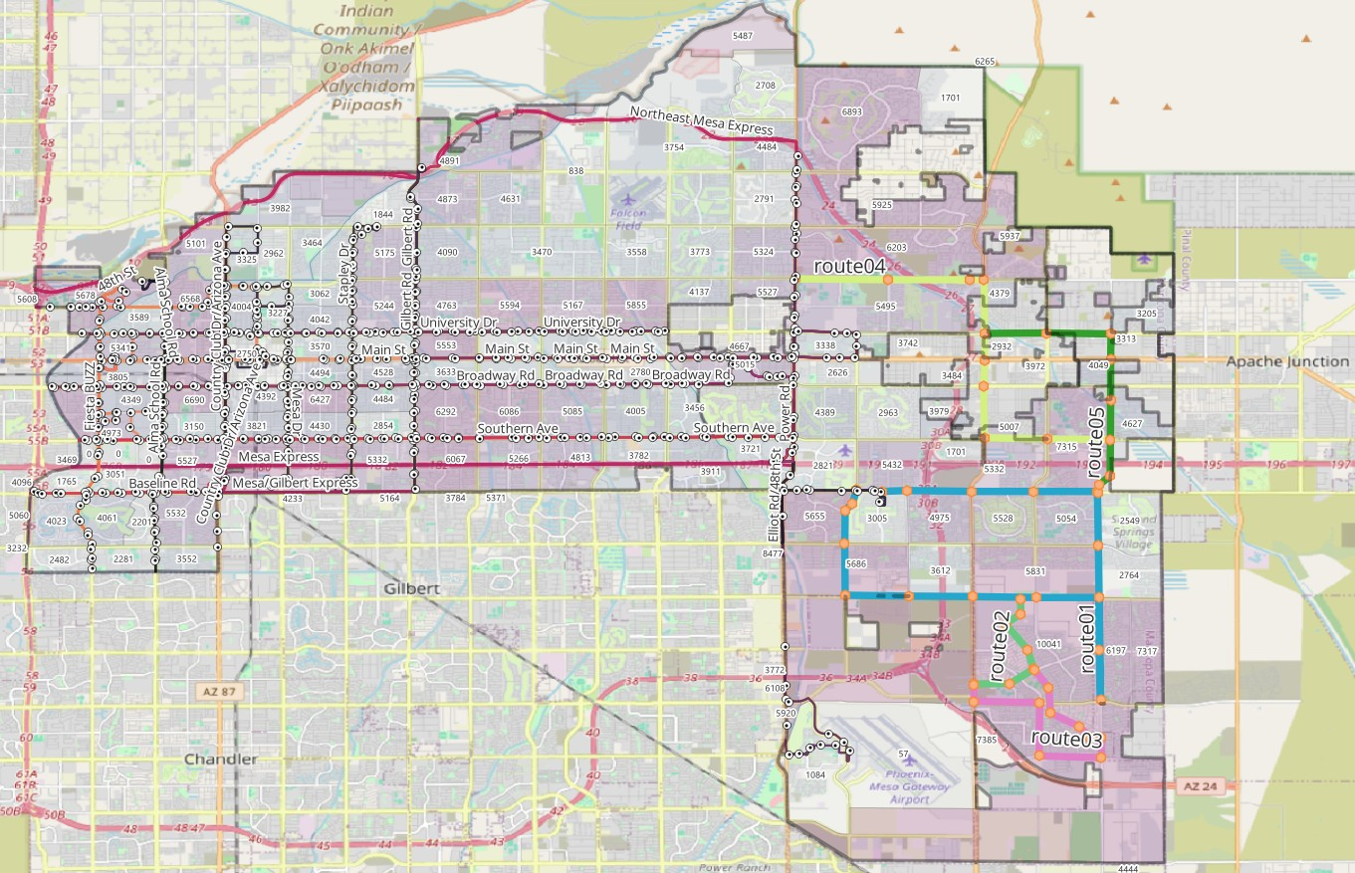
Proposed Bus Routes and Stops
5 new bus routes and 45 bus stops across the north-east and south-east parts of mesa

Slide 16
Post Bus Route creation analysis
Buffering and Accessibility Analysis -A 500-meter buffer was applied to the new bus routes to simulate walking accessibility - This was intersected with the census tracts to calculate overlapping areas
Overlap Ratio and Population Impact -The area of overlap and the total tract area were calculated using the “Field Calculator” and a new attribute (overlap_ratio) was added to express the proportion of each tract covered by the buffer -Tracts with at least 20% overlap were retained, representing zones likely to experience meaningful accessibility improvement -A weighted population field (pop_contributed) was calculated by multiplying each tract’s population by its overlap ratio
Notes:
All about our methodology - the data sets we used and procured (bus ridership, temperature datasets, GIS datasets - census tracts, public transit routes and stops, population data), how we performed the bus ridership analysis and a basic idea of what we gained from it, how we performed the rising temperature analysis, and GIS analysis. Check report for info most of the stuff should be there or discuss in the group. Add slides as we seem fit, but since this is a presentation we need to keep the text limited and explain our work more.

Slide 17
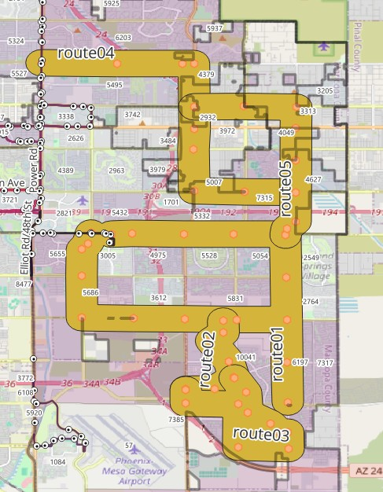
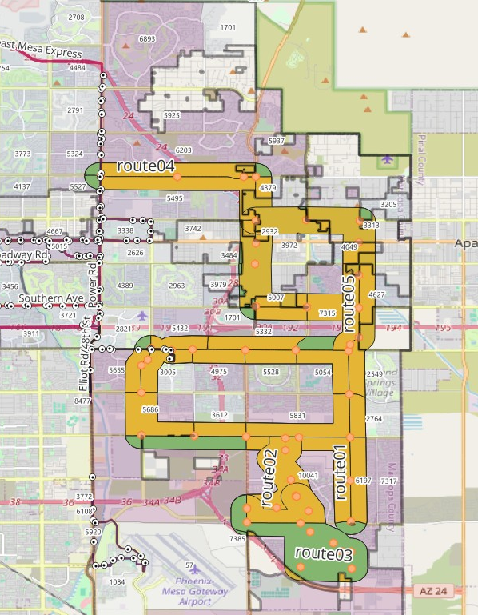
Post Bus Route creation analysis
The total estimated population of ~63,413 people newly served and directly affected by proposed routes
Bus Routes with a 500m buffer for accessibility
Overlapping areas of the bus route with a 20% threshold

Slide 18
1.
Introduction
2.
Objectives
3.
Methodology
4.
Results and Significance

Slide 19
Projected Reduction in Carbon Emissions
Once we created the bus routes and stops, the next step was to analyse what kind of impact that could have as far as Carbon Emissions go.
For this analysis, we considered various scenarios and national averages -An uptake of 5%, 10% and 15% -Average trip lengths of 5 miles and 12 miles (national average is 12.2 miles) -250 work days across the USA -Bus capacities of 10 and 20 - to emulate a full bus and a relatively empty bus journeys -Average Carbon Emissions for a diesel bus per mile of 2680 g -Average Carbon Emissions for an electric bus per mile of 100 g -Average Carbon Emissions for a car per mile of 404 g
Notes:
All about our methodology - the data sets we used and procured (bus ridership, temperature datasets, GIS datasets - census tracts, public transit routes and stops, population data), how we performed the bus ridership analysis and a basic idea of what we gained from it, how we performed the rising temperature analysis, and GIS analysis. Check report for info most of the stuff should be there or discuss in the group. Add slides as we seem fit, but since this is a presentation we need to keep the text limited and explain our work more.

Slide 20
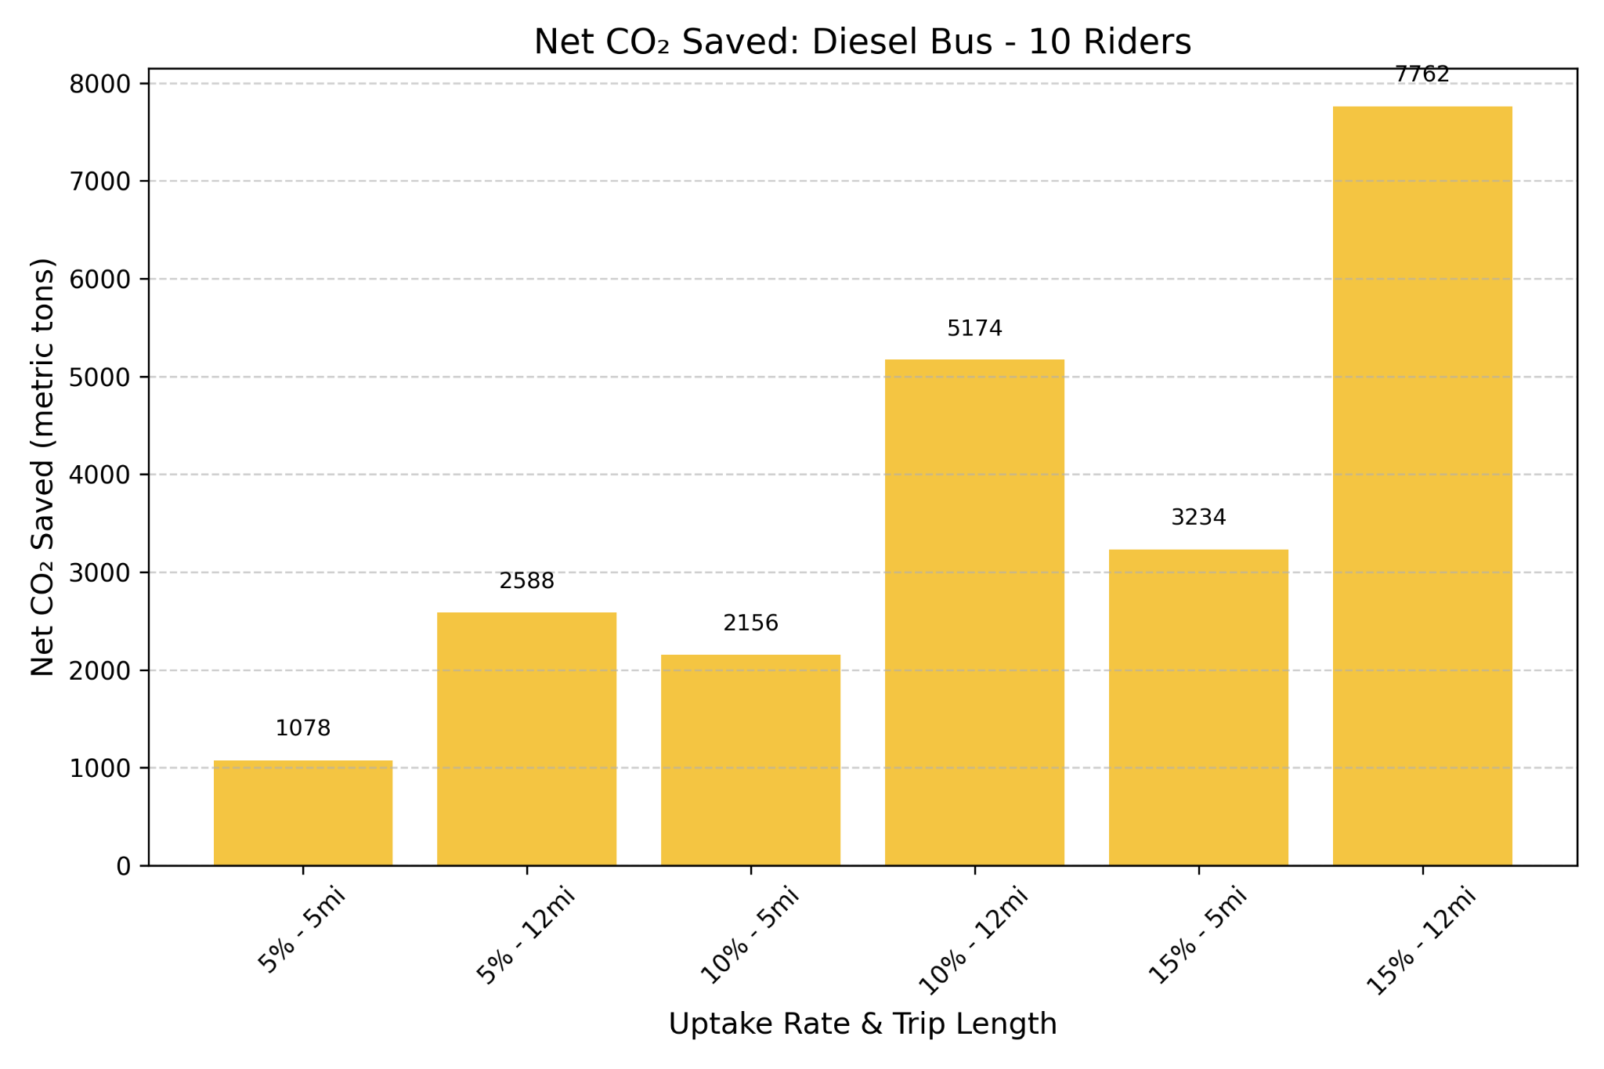



Projected Reduction in Carbon Emissions
An Average of 8000 metric tonnes of Carbon Emissions can be reduced
Notes:
All about our methodology - the data sets we used and procured (bus ridership, temperature datasets, GIS datasets - census tracts, public transit routes and stops, population data), how we performed the bus ridership analysis and a basic idea of what we gained from it, how we performed the rising temperature analysis, and GIS analysis. Check report for info most of the stuff should be there or discuss in the group. Add slides as we seem fit, but since this is a presentation we need to keep the text limited and explain our work more.

Slide 21
But what does an average of 8000 metric tonnes of Carbon Emissions reduced even mean?
Notes:
This slide (maybe one more in a similar format) should be about temperature trends and bus trends in mesa, and how carbon emissions are the major cause of rising tempratures

Slide 22
According to Greenhouse Gas Equivalencies Calculator (epa.gov)
🚗 Taking cars off the road for 20 million miles
✈️ Canceling 8,000 cross-country flights
🌳 Planting over 400,000 trees and letting them grow for a decade
🏠 Powering 808 homes for a full year
⛽ Avoiding the use of 900,000 gallons of gasoline
📦Delivery of 20 million ecommerce packages
Notes:
This slide (maybe one more in a similar format) should be about temperature trends and bus trends in mesa, and how carbon emissions are the major cause of rising tempratures

Slide 23
Financial Recommendations
Valley Metro
< $3M were allocated for VM personnel & maintenance last year of $158M
Micro shelters for 45 new stops—total $540k (0.15% of AZ foreign aid in 2023)
City budgets from the police department can be reallocated to infrastructure
Building bus shelters would create new jobs during this recession
Notes:
All about our methodology - the data sets we used and procured (bus ridership, temperature datasets, GIS datasets - census tracts, public transit routes and stops, population data), how we performed the bus ridership analysis and a basic idea of what we gained from it, how we performed the rising temperature analysis, and GIS analysis. Check report for info most of the stuff should be there or discuss in the group. Add slides as we seem fit, but since this is a presentation we need to keep the text limited and explain our work more.

Slide 24
Strategic Route Expansion: Five new bus lines with 45 stops—at an estimated $540 K (< 1 % of the Valley Metro budget)—can cut private-vehicle CO₂ emissions by roughly 1,200 tons per year.
Heat-Risk Reduction: Enhanced transit options during 100 °F+ days lower outdoor exposure, directly improving public health outcomes.
Equity Gains: Reliable, air-conditioned mobility especially benefits seniors, low-income households, and unhoused residents.
High Return on Investment: Environmental and social benefits far outweigh the modest capital outlay, delivering strong ROI.
Scalable Framework: This data-driven approach can be replicated across other Sun-Belt cities wrestling with rising temperatures and transport emissions.
Notes:
These next few slides should talk about how in conclusion the state of mesa is pretty fucked and it needs immediate action and climate change is very real and promoting bus routes is a very simple and easy way to go about it. We can also add risks and barriers here itself should we need to.

Slide 25
Data Sources
https://www.valleymetro.org/about/agency/transit-performance/finance-budget-reports
https://www.valleymetro.org/about/agency/transit-performance/ridership-reports
https://data.mesaaz.gov/Transit-Services/Bus-Ridership/nmjv-498y/about_data
https://data.mesaaz.gov/Environmental-and-Sustainability/City-Energy-Usage/ksen-g4gs/about_data
https://data.mesaaz.gov/Planes-Trains-Automobiles/Bus-Ridership-by-Month/mnst-39et
https://www.ncdc.noaa.gov/cdo-web/api/v2/data
https://www.census.gov/geographies/mapping-files/time-series/geo/tiger-line-file.html
https://opengis.mesaaz.gov/datasets/b56f02cdc87643b593ceebcd28669564_0/explore?location=33.394749%2C-111.737377%2C11.69

